Slide 1
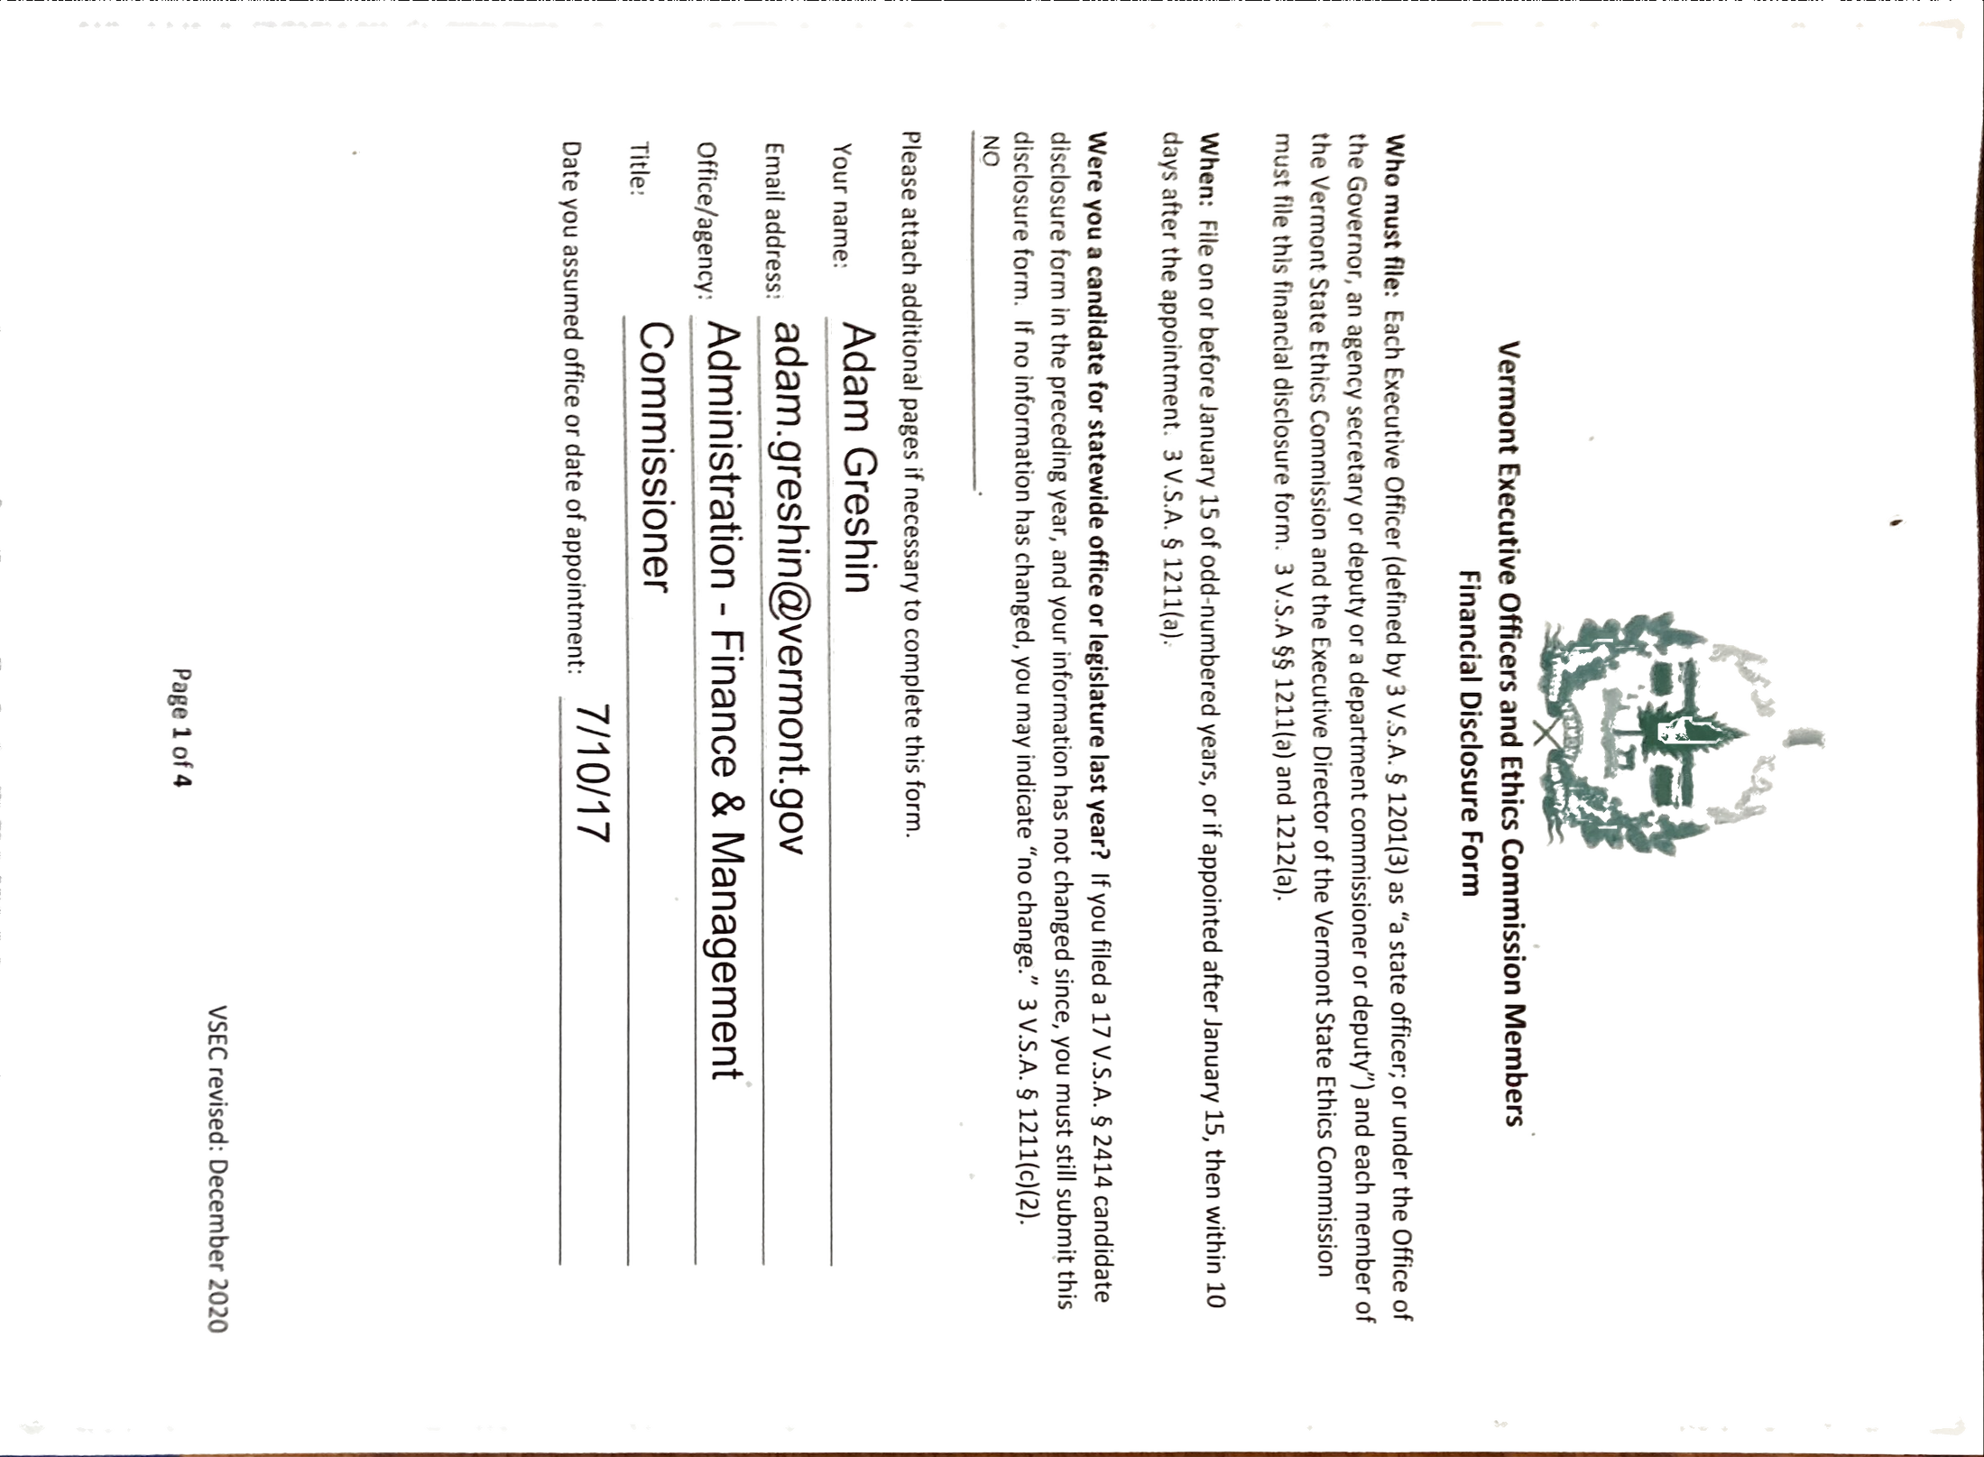
Notes:
Image with background removed

Slide 2
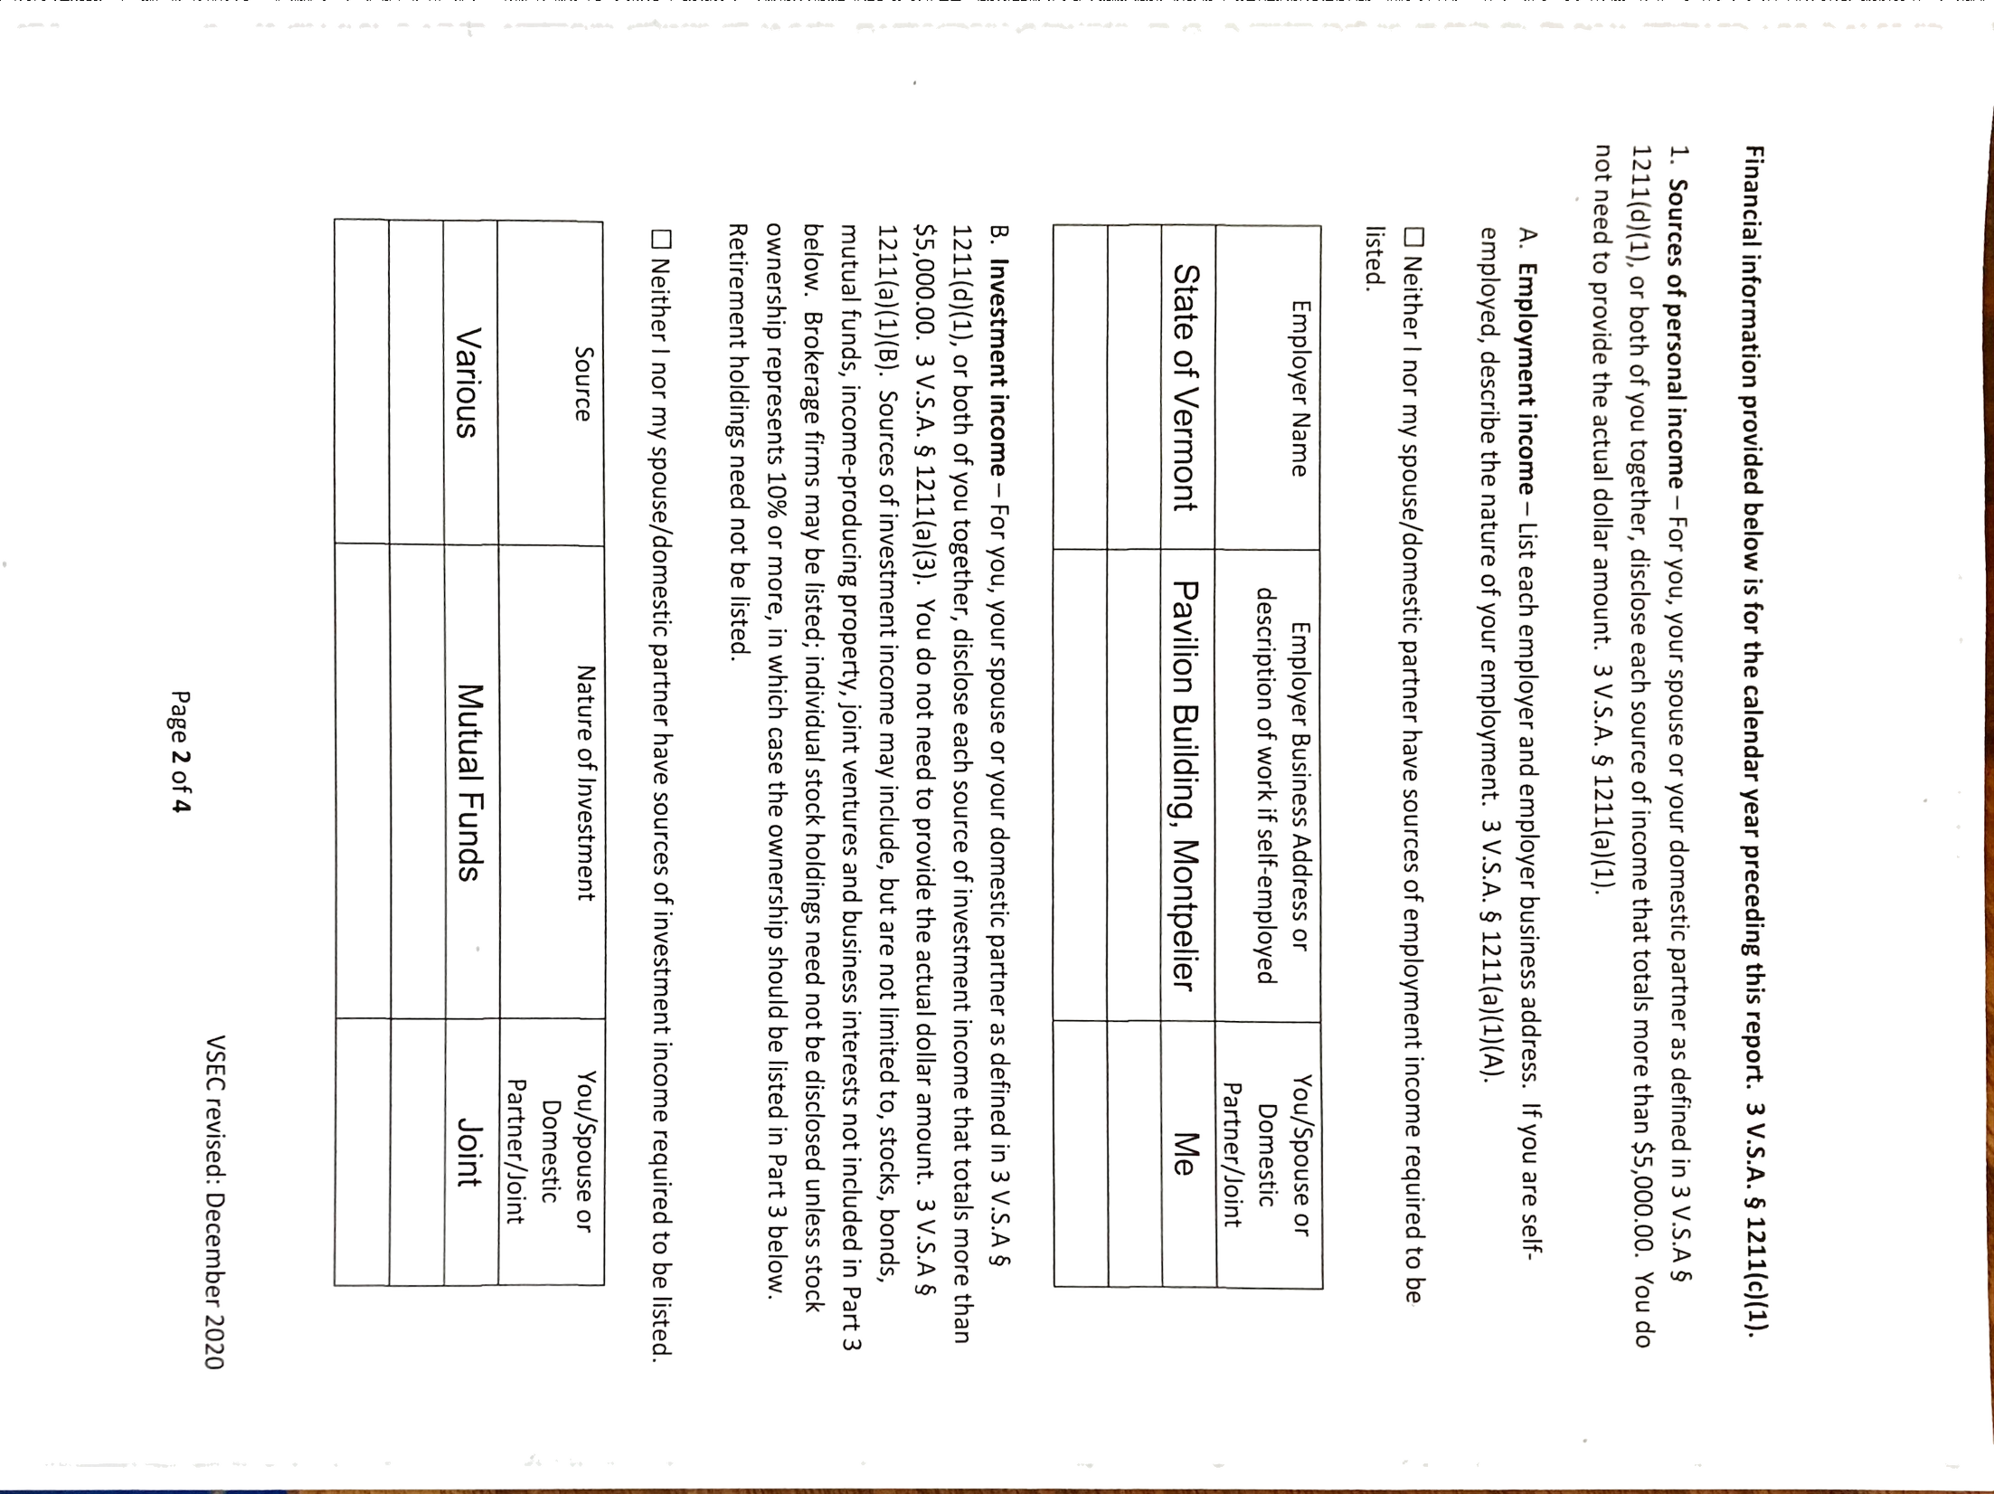
Notes:
Image with background removed

Slide 3
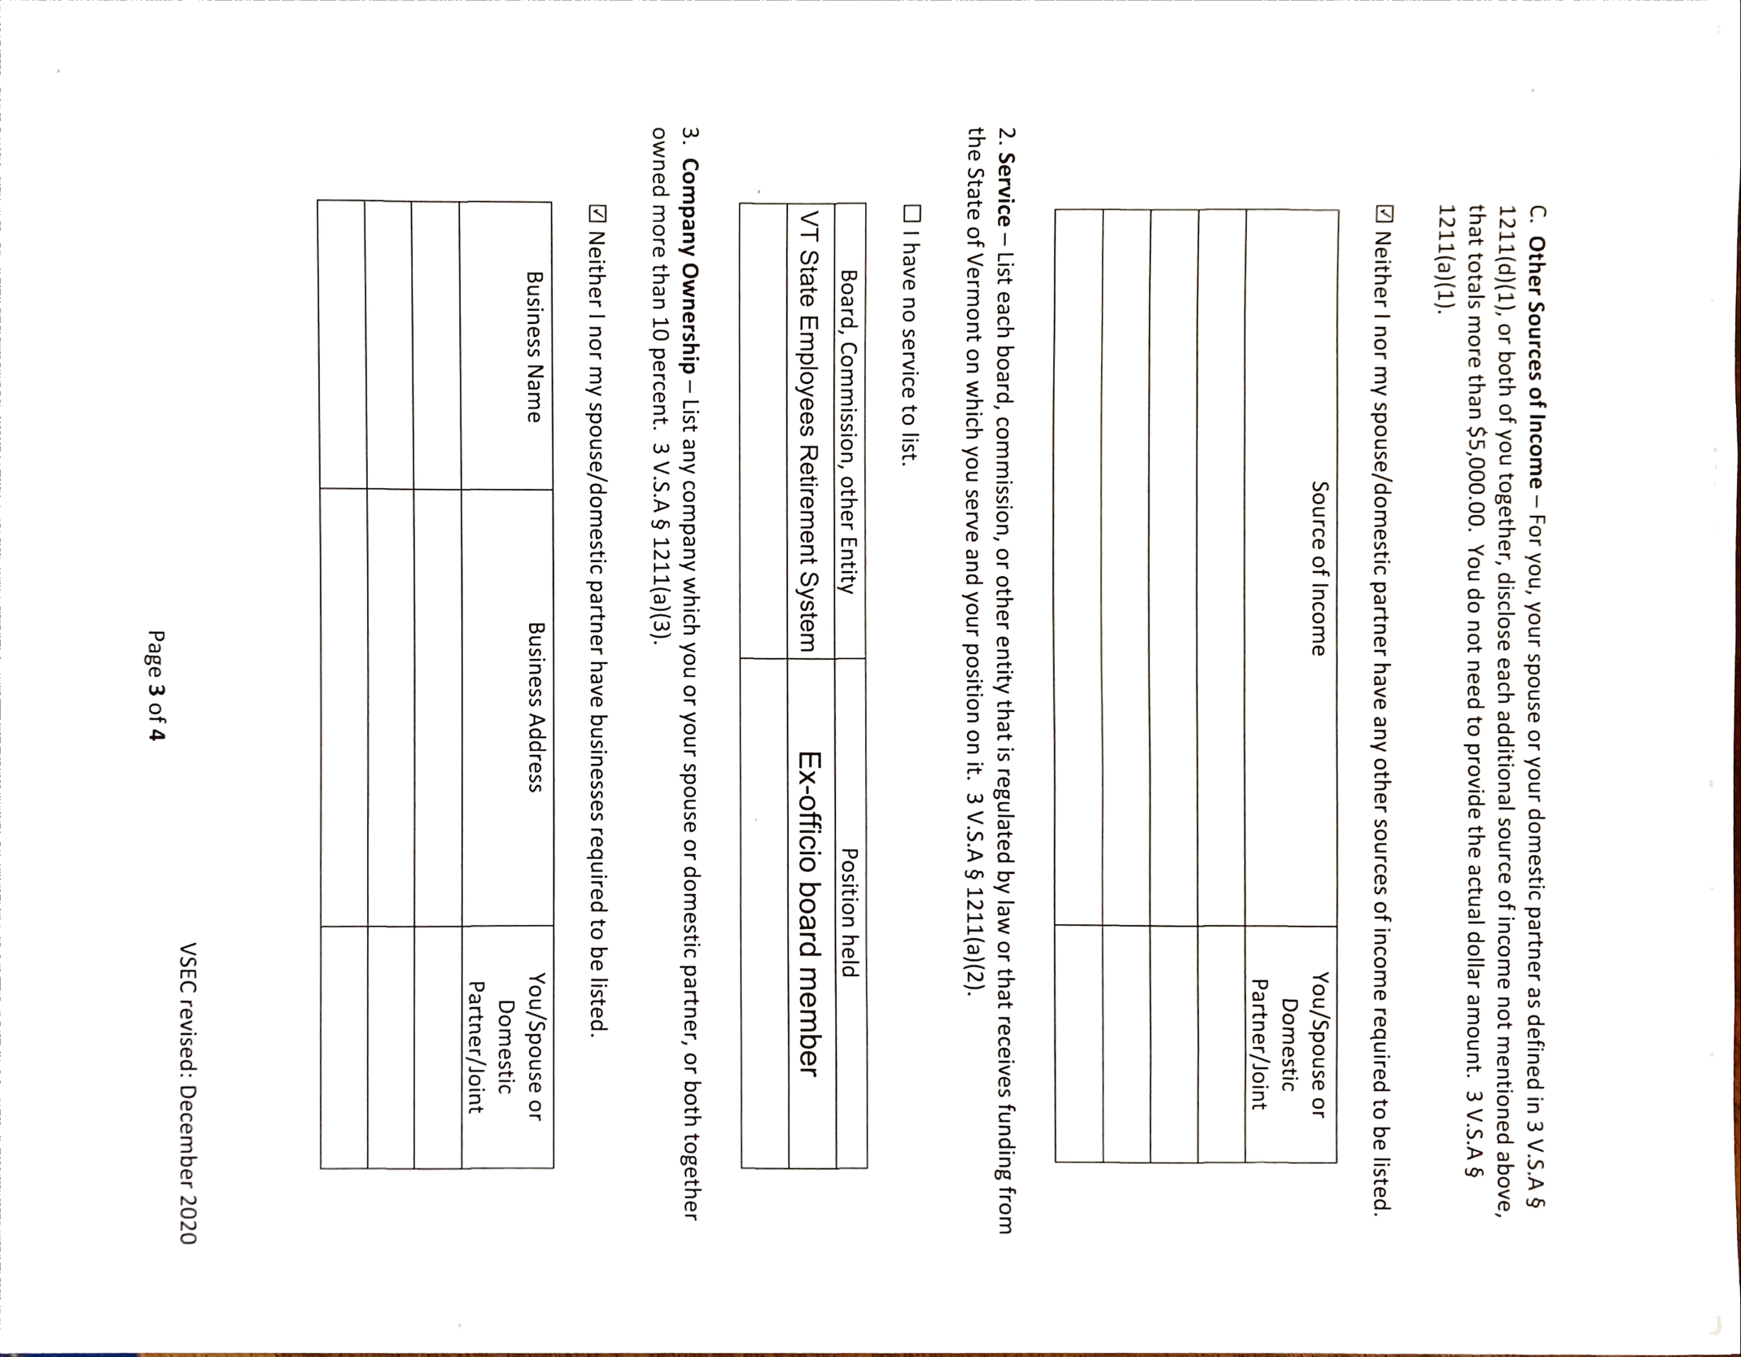
Notes:
Image with background removed

Slide 4
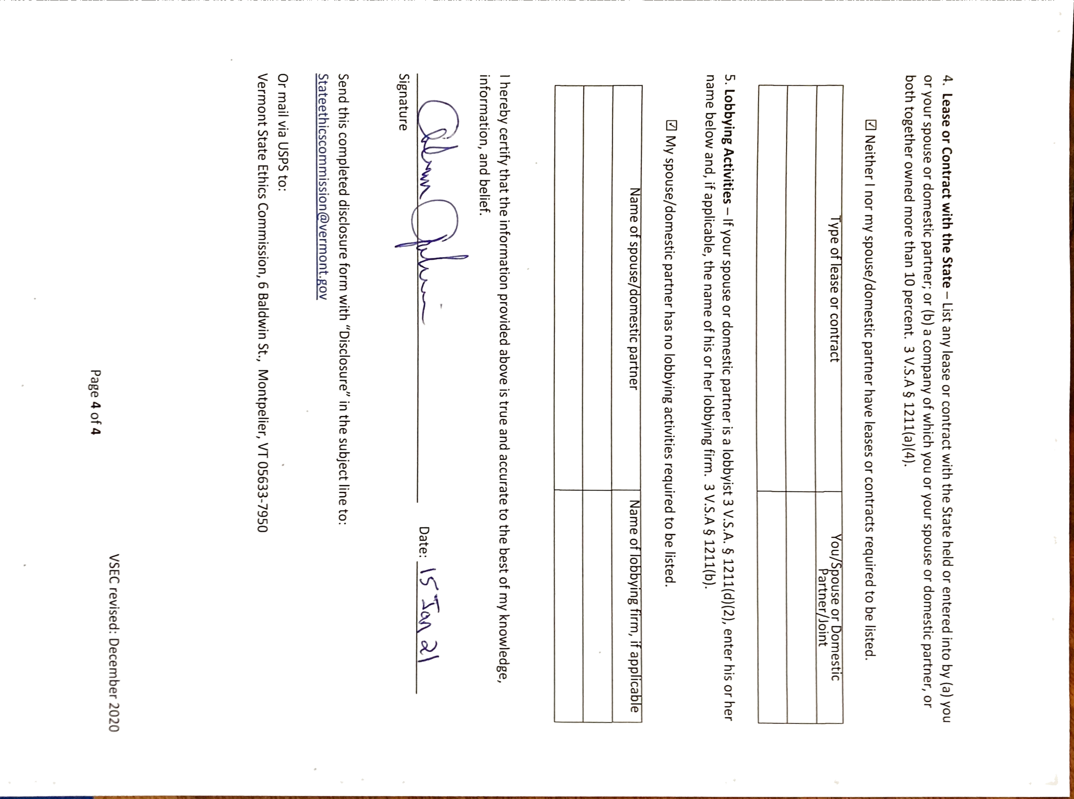
Notes:
Image with background removed

